Slide 1
Breathalyzer
ECE 372A – MICROCONTROLLER ORGANIZATION
ELECTRICAL AND COMPUTER ENGINEERING
UNIVERSITY OF ARIZONA
SPRING 2019

Slide 2
Team Members
Group 2
Philippe Cutillas
Sam Badger
Cordell Freeman
Hernani Fernandes

Slide 3
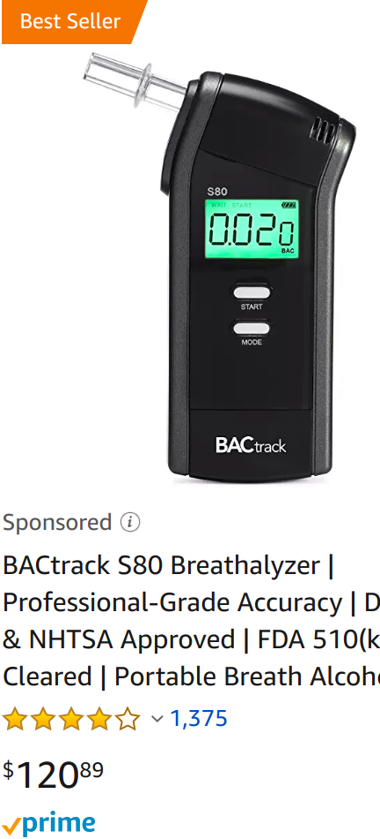
Statement of Problem
Many people are unaware of their Blood-Alcohol content when drinking alcoholic beverages, especially in larger amounts. Due to this, some may believe they are more sober than they might actually be, leading them to make bad choices, such as driving under the influence.
Although there are many breathalyzers on the market today, they can be costly or inaccurate.
Even The most expensive breathalyzers only last a few years before the sensor loses accuracy.
An unhappy Customer:

Slide 4
Proposed Prototype Solution
The prototype has the following components:
A Replaceable battery
A button to take the measurement
A replaceable MQ-3 Alcohol Sensor
A 7-segment display for showing the BAC
A piezo buzzer that beeps once when the measurement has been taken and twice when the BAC is above the legal limit.
A mouthpiece to breath into.
Arduino AT-Mega 2560 for controlling the breathalyzer.
The prototype is a hand-held device that could easily be tucked in your pocket and carried around. To take a measurement, the user presses the measurement button once, breathes into the mouthpiece, hears a beep, and reads the display. If the BAC reads above 0.08, 2 more beeps are made telling the user they shouldn’t operate a vehicle.

Slide 5
Requirements
The system must measure the blood alcohol content (BAC) using an alcohol sensor - The arduino will be set up to perform immediate calculations based on inputs from the sensor.
The system must beep once when a sample is taken and then beep twice if BAC is above legal limit.
The system must display the BAC on a seven-segment display
The system must use a single button to wake the device up and put it back to sleep. It will reset the BAC reading after a few seconds.

Slide 6
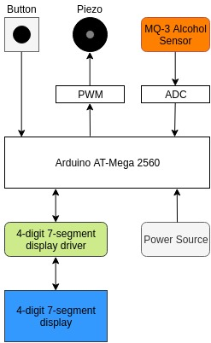
System Architecture Diagram
An analog signal is read from the MQ-3 sensor. The internal ADC of the arduino is used to convert to digital.
The piezo buzzer is operated at 880 Hz.
The power source directly powers the Arduino which in turn powers all other devices.
The 4-digit 7-segment display driver is software. The rest of the diagram is hardware.
The power source is a 9V battery.

Slide 7
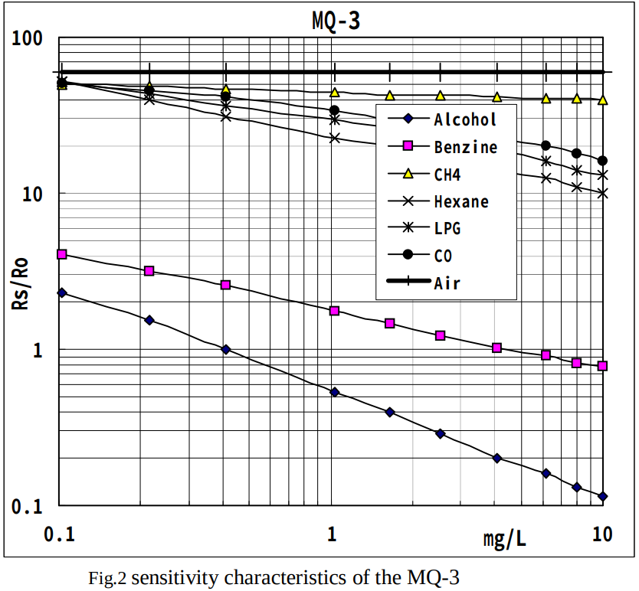
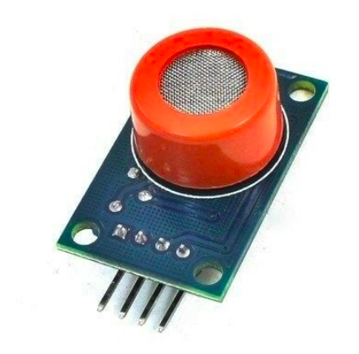
MQ-3 Alcohol Gas Sensor
Gases Detected:
High sensitivity to alcohol gas
Small sensitivity to Benzine gas
Limitations:
maximum humidity: 95%
maximum temperature: 50 degrees celsius
Oxygen concentration should be 21% (standard)
For best results, sensor should be warmed up to 40 degrees celsius
This can take up to 15 minutes using the internal heating source.
Pins:
Vcc - powers alcohol sensor and internal heating element
Comes from external power supply
Aout - analog reading
Dout - digital reading (no documentation)
GND - ground on arduino
When calibrating, use 0.4mg/L of alcohol concentration in air and use 200KOhm load resistance as suggested in datasheet.

Slide 8
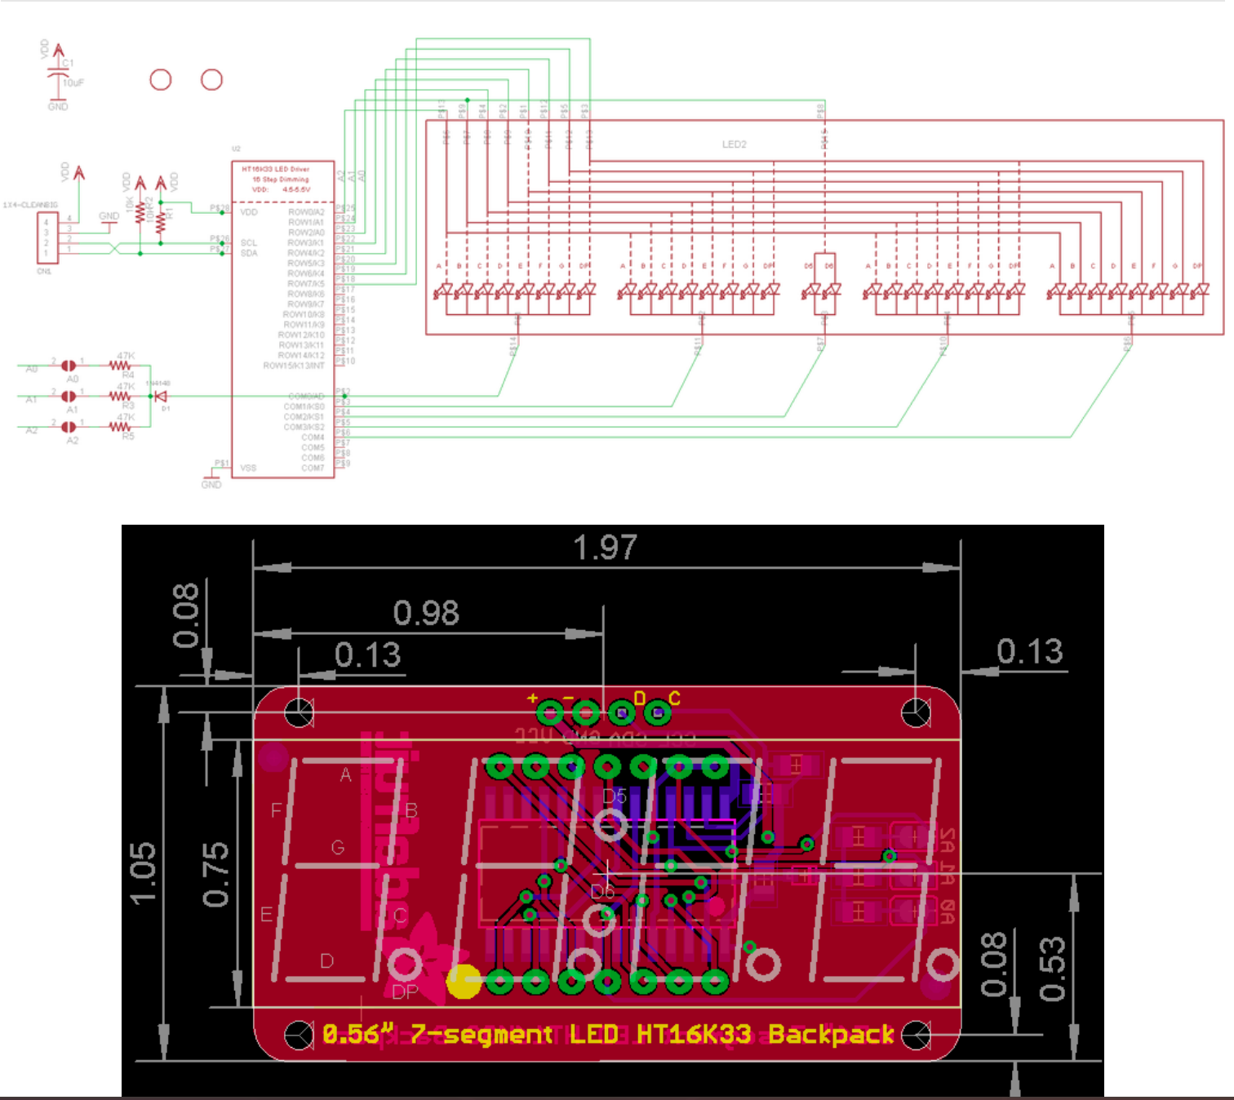
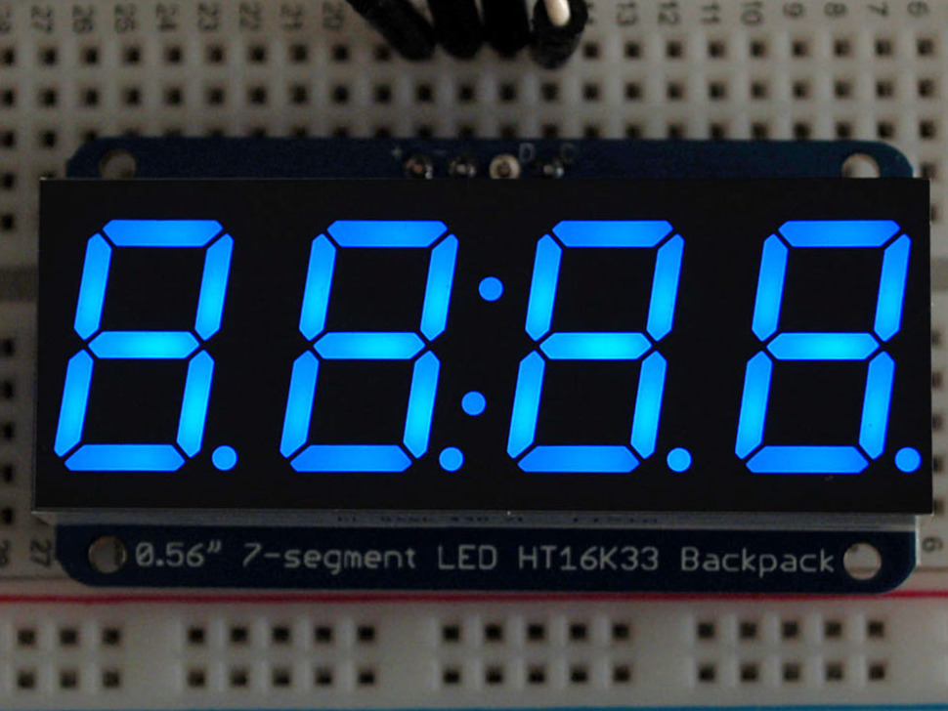
Adafruit 4 Digit 7-Segment Display
Uses I2C communication protocol
Backpack Dimensions: 27mm x 50mm x 4mm / 1.1" x 2" x 0.16"
Backpack Weight: 5.3g
7-Segment Display Dimensions: 19mm x 50mm x 14mm / 0.75" x 2" x 0.56"
7-Segment Display Weight: 8.4g

Slide 9
Software Functions
Files created:
i2c.cpp - Controlled the I2C communication between parts
lcd.cpp - Allowed display of information on 7-segment display
main.cpp - Contained state machine and implemented all other functions
mq3.cpp - Allowed for reception of signal/information from MQ3 sensor
piezo.cpp - Allowed for control of Piezo buzzer
switch.cpp - Allowed for functionality of button to turn device on/off
timer.cpp - Timer used for various functions throughout project
Example: Piezo buzzer waits for reading from sensor, then beeps once using function from piezo.cpp. It then waits again for the arduino to finish calculating BAC, after which it beeps twice only if the BAC is high enough, using another function from piezo.cpp

Slide 10
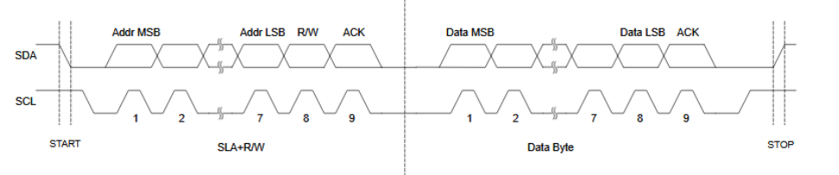
Communication Protocol
The I2C communication protocol was used to write to the 4-number 7-segment display, in order to display the reading for the Blood Alcohol Concentration.

Slide 11
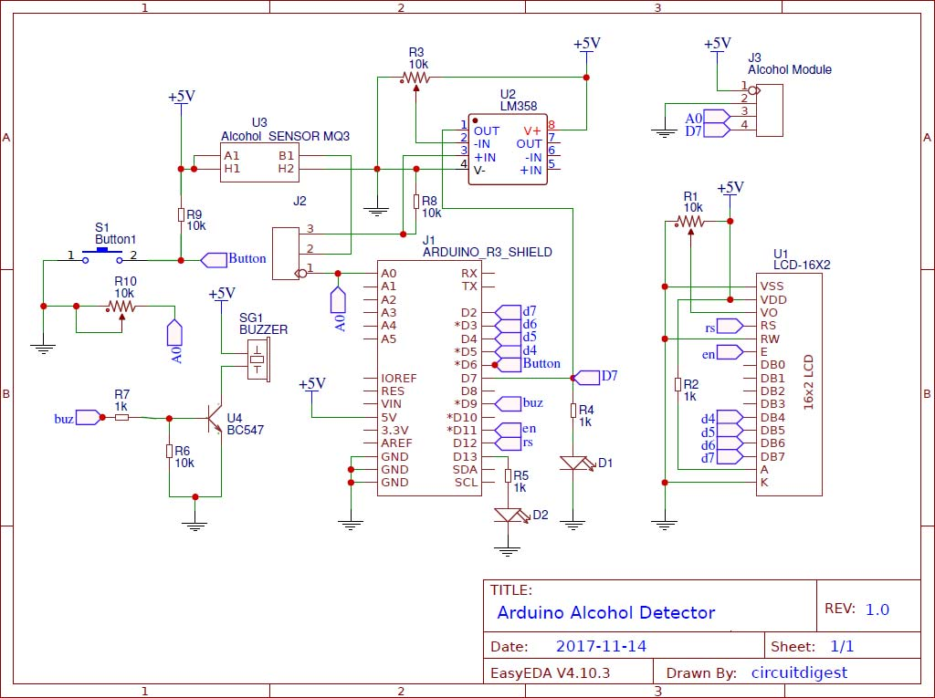
Circuit Diagram
More complicated than ours and uses a different arduino, but otherwise has similar components
Notes:
I found this circuit diagram on the web, I probably does not match with the ports we are using on ours, but I think we can use. It’s missing the 7 segment part, but we can mention in the presentation

Slide 12
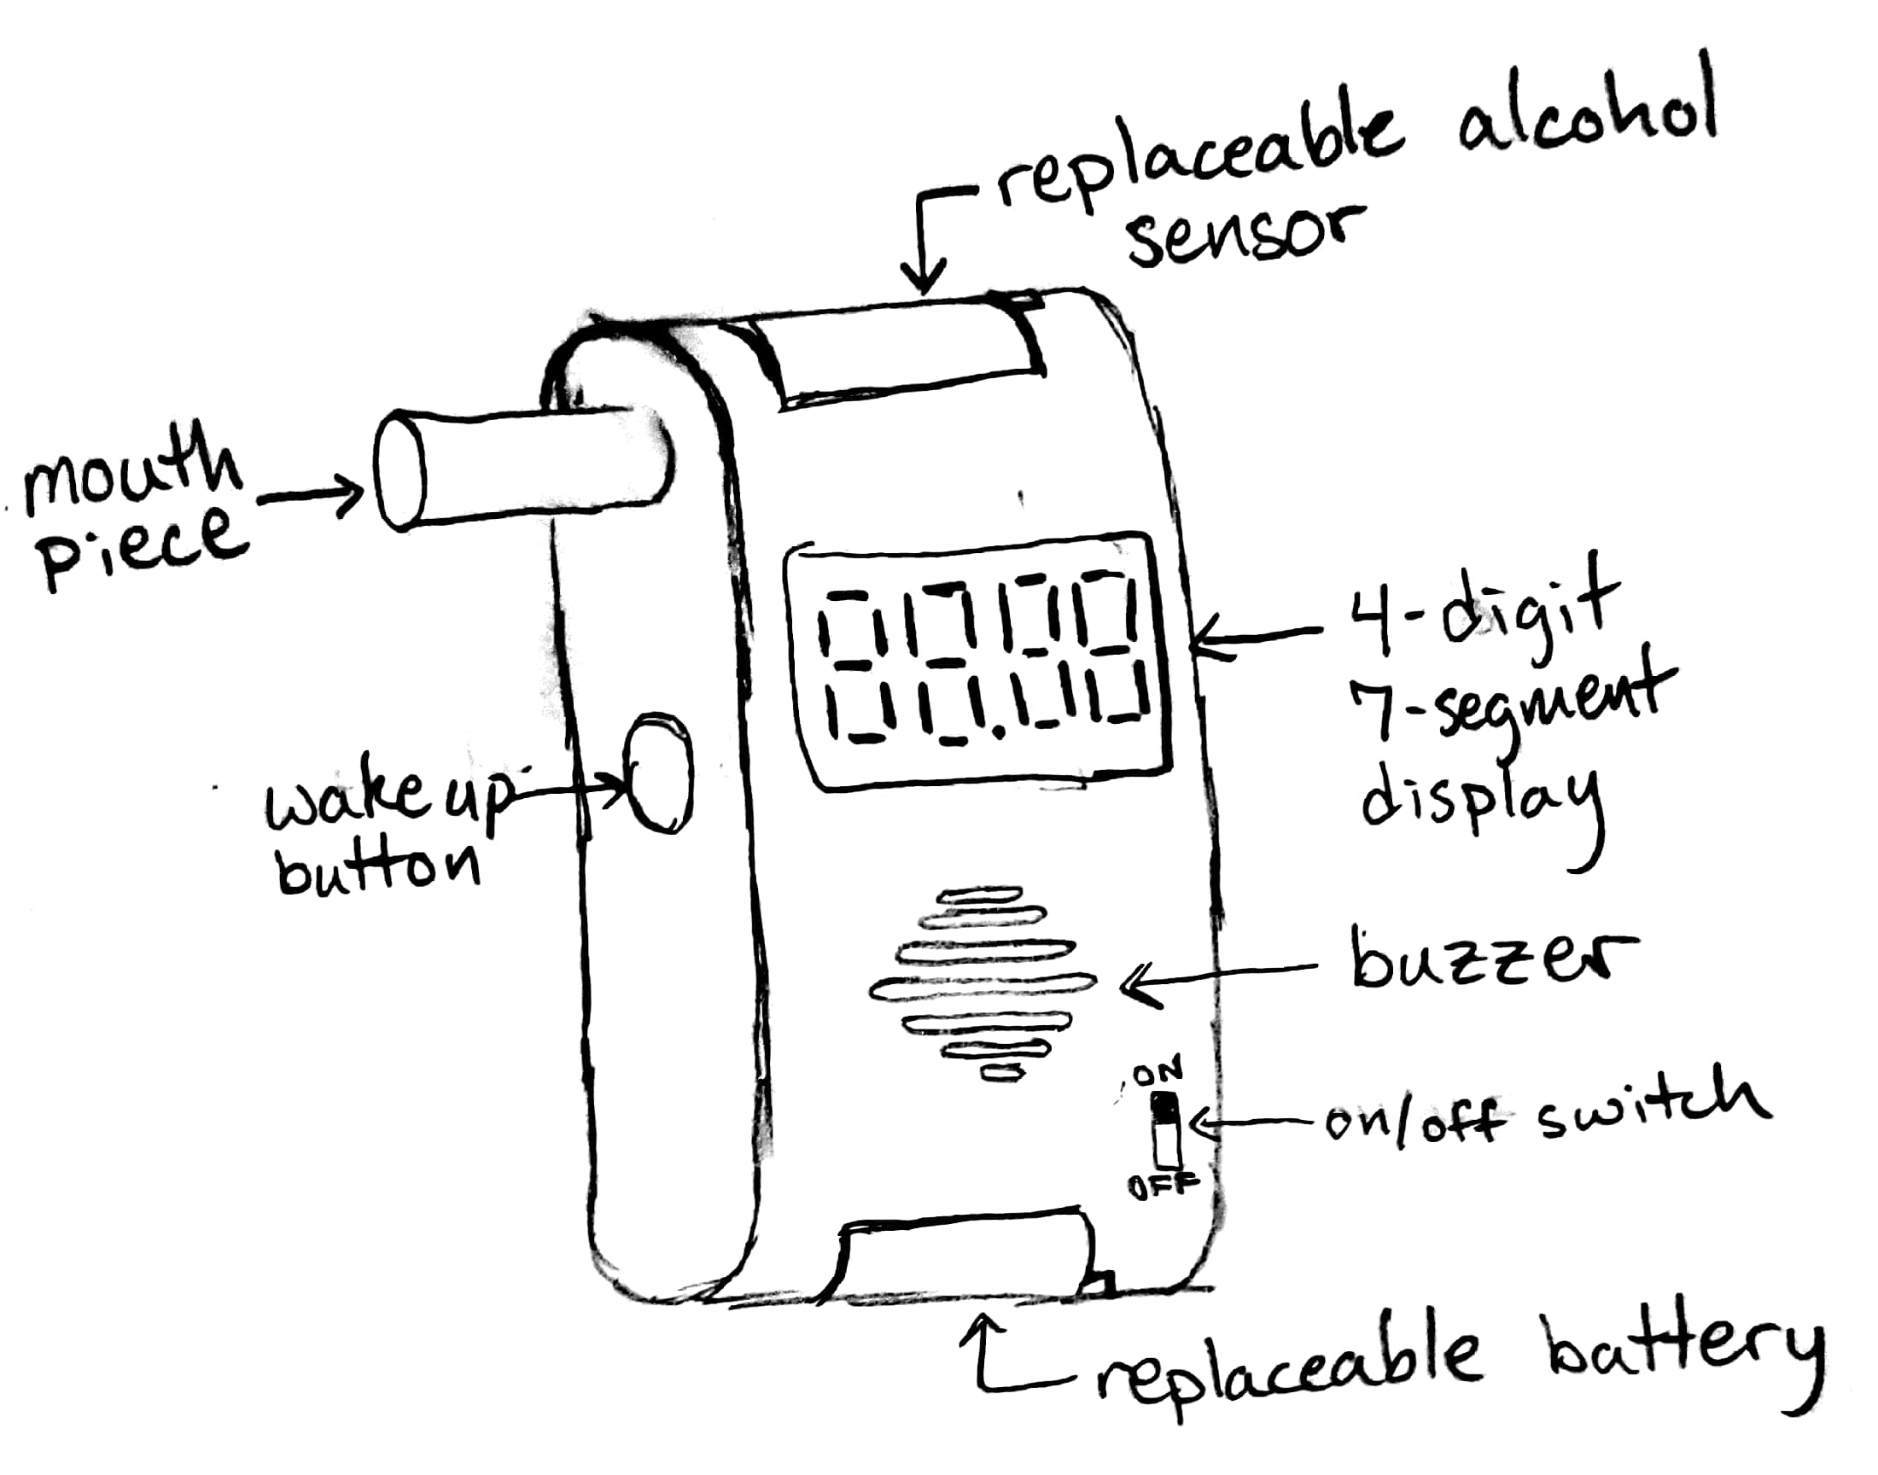
Mechanical Diagram

Slide 13
Power Consumption
Because this is a hand-held battery-powered device, power consumption is very important.
We Estimate that our breathalyzer draws about 460mA. A 9V battery has a capacity of 500mAh.
It would run on a 9V charge for about 1 hour and 5 minutes.
The alcohol sensor draws the most current because it has an internal heating element.

Slide 14
Bill of Materials
MQ-3 Alcohol Gas Sensor $4.95
Adafruit 4-digit 7-segment display $11.95
Piezo Buzzer $1.50
9V Battery $6.65
Push Button $0.21
Arduino AT-Mega 2560 $14.99
Wires $0.50
On/Off slide switch $0.69
Total Cost of Production $41.44

Slide 15
Project Plan and Milestones
Key Milestones | Start Date | End Date | Duration (days)
Project Kickoff | 04/15
System Diagram | 04/15
Code Developed for | 04/15
Parts Ordered | 04/10 | 04/14 | 5
Implementation | 04/22 | 04/29 | 8
Demo | 04/29 | 04/29 | 1
Presentation | 05/9 | 05/9 | 1

Slide 16
Results
The breathalyzer works as expected. When the user presses the button to take a measurement and then breathes into the mouth piece, the buzzer beeps once.
The blood alcohol concentration is then displayed on the 7-segment display.
If the BAC is greater than 0.08, the buzzer beeps twice.
After a few seconds, the display is cleared.
The power consumption is a little high for a hand-held device, especially since 9V batteries cost so much.
Ideally, we would use a smaller board to make the product smaller, cheaper, and more energy efficient.

Slide 17
Final Rubric
Criteria | Level 4 | Level 3 | Level 2 | Level 1 | Outcome
MQ-3 Alcohol Gas Sensor | Completely working without Wire Library | Continuous readings using Wire Library | Sensor working with Wire Library | Sensor does not working at all | Level 4
Adafruit 4 Digit 7-Segment Display | Completely working without SevSeg or any essential Library | Works using SevSeg Library or other essential Library | Receives data but does not display correctly | Display does not work at all | Level 4
Button | Completely working using non essential libraries | Works using Arduino Libraries & Functions | Button does not work properly | Button does not work at all | Level 4
Piezo Buzzer | Completely working using non essential libraries | Works using Arduino Libraries & Functions | Sound does not relate to the status of the system | Buzzer does not work at all | Level 4

Slide 18

Summary
Our breathalyzer is functional, providing on/off functionality, audio and visual cues, and accurate readings of BAC, giving an audible warning if the BAC is above the legal limit for driving.

